Slide 1


Slide 2
SNAKE GAME
Made With :HTML, CSS and JAVA SCRIPT
Made by : Ishu Kumar
Hritik Kumar
Kaushlendra Pratap Singh
Kalpit Sharma

Slide 3
Abstract
The modern web has quickly become a viable platform not only for creating stunning, high quality games, but also for distributing those games.
The range of games that can be created is on par with desktop and native OS counterparts. With modern Web technologies and a recent browser, it's entirely possible to make stunning, top-notch games for the Web. And we're not talking about simple card games or multiplayer social games that have in the olden days been done using Flash. We're talking about 3D action shooters, RPGs, and more. Thanks to massive performance improvements in JavaScript just-in-time compiler technology and new APIs, you can build games that run in the browser (or on HTML5-powered devices like those based on Firefox OS) without making compromises.
And we started our journey in game development by developing the basic snake game.

Slide 4
Introduction
In this project or the game we made a snake game for desktop by using HTML , CSS , Java Script. In this game we tried to copy the game which was played in older times in the keypad mobile with a little better graphics and better colours.
In the game of Snake, the player uses the arrow keys to move a "snake" around the board. As the snake finds food, it eats the food, and thereby grows larger. The game ends when the snake either moves off the screen or moves into itself. The goal is to make the snake as large as possible before that happens.
It also show the score made my the player as well as the high score of the player.

Slide 5
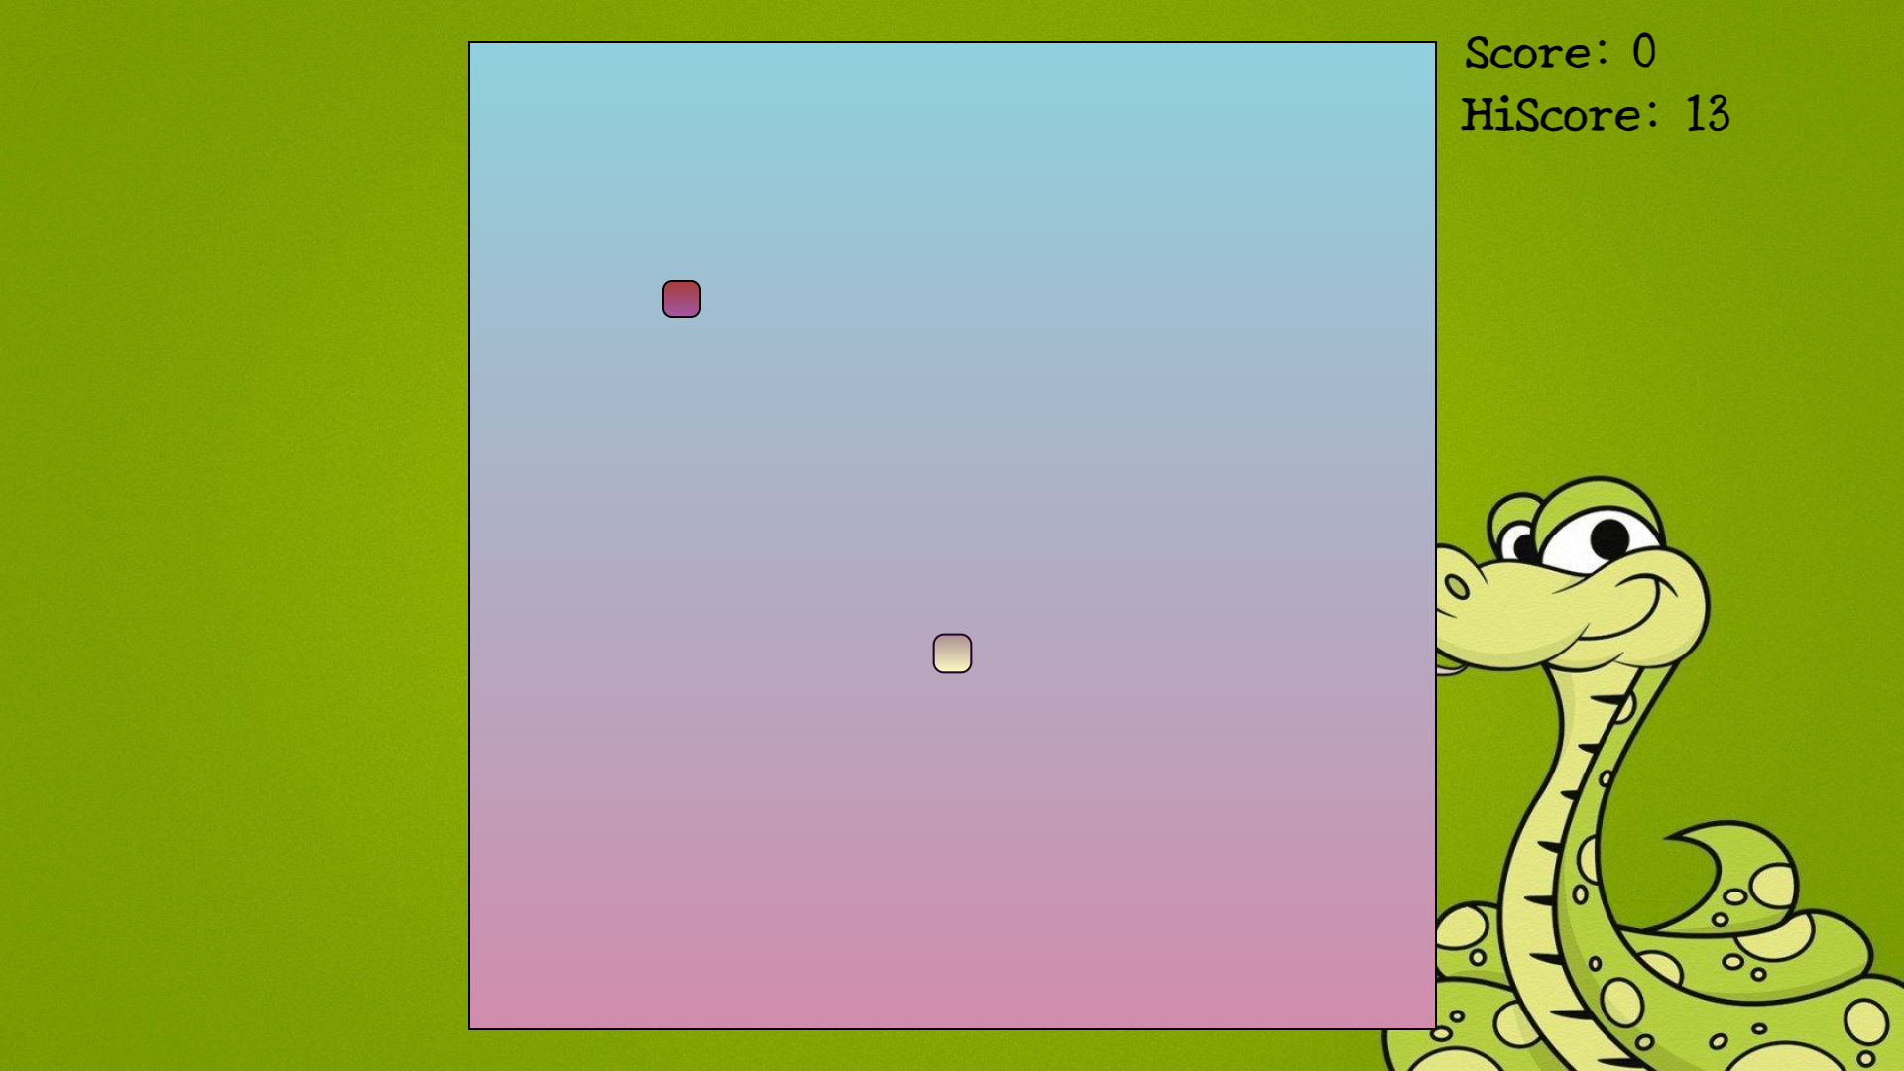

Slide 6
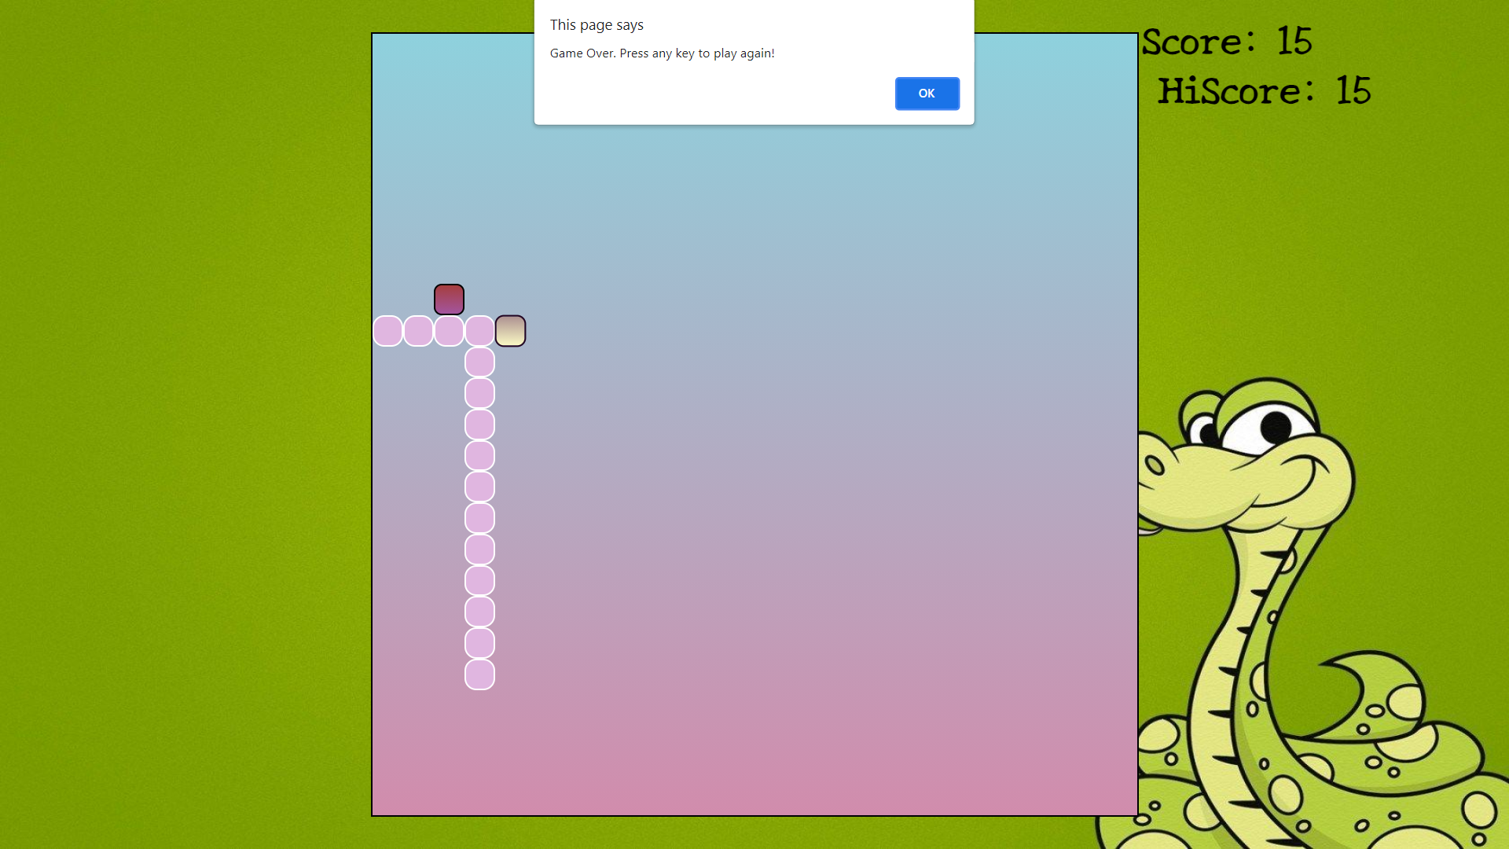

Slide 7
When will Snake die
When Snake will get stuck into itself or get stuck with wall or border.
How to score point
The Snake will score by Eating the given food 1 point will add

Slide 8
Working of Snake Game
By using right arrow key the snake will move right.
By using left arrow key the snake will move left.
By using down arrow key the snake will move down.
By using up arrow key the snake will move up.

Slide 9
Repository link of github of the project
https://github.com/Ishu214214/Snake-game

Slide 10

Any querry ?
.

Slide 11


